Slide 1
READ ME This template uses the font ‘Space Grotesk’ – be sure to download the font before making edits to the deck. Here’s the link to the ZIP file containing the font. If you cannot access the link above, you can download the font for free via Google Fonts.

Slide 2
Spring Boot Backend

Slide 3
Migrate from ASP.NET Core Web API

Slide 4
Spring Boot CLI for scaffolding

Slide 5
Azure OpenAI SDK for challenge

Slide 6
Integration with Blazor frontend

Slide 7
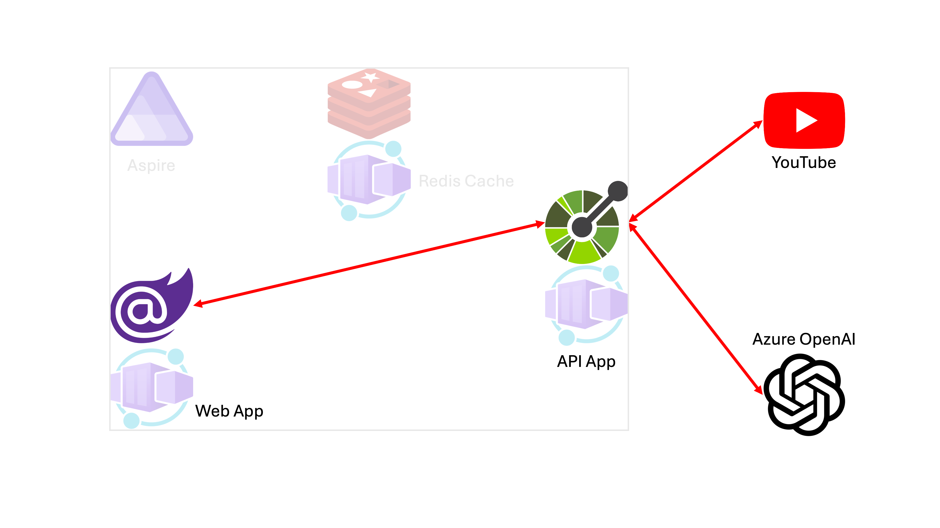

Slide 8
Let’s get started!
https://bit.ly/gh-copilot-lite

